Slide 1
THE
GREAT DEPRESSION

Slide 2
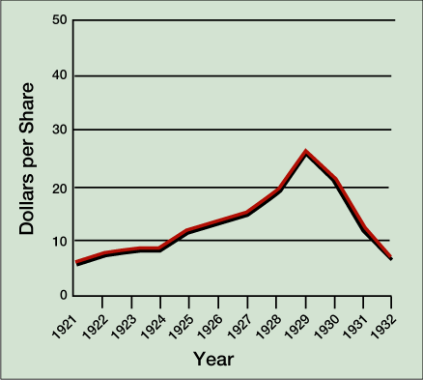
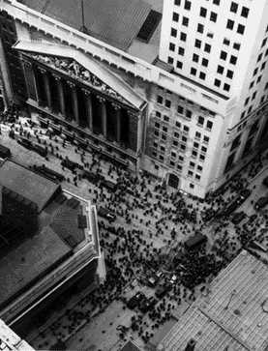

STOCK MARKET CRASH
Stock Market Prices, 1921–1932
May 1928-September 1929, prices doubled in value
beginning in Sept 1929, gradual slide
Black Thursday (Oct. 24)
  largest sell-off in NYSE history
Black Tuesday (Oct. 29)
  $40 billion in stock value lost by Dec.
The Great Depression
Response of bankers, Hoover and business leaders
Notes:
Faragher, Out of Many, 3rd Ed.; http://wps.prenhall.com/hss_faragher_outofmany_ap/

Slide 3
UNDERLYING CAUSES OF THE DEPRESSION
Overproduction - Massive business inventories (up 300% from 1928 to 1929)
Lack of diversification in American economy
  prosperity of 1920s largely a result of construction & auto industries
Uneven distribution of income and wealth - Poor distribution of purchasing power among consumers
  Farm income down 66% in 20s
  By 1929 the top 10% of the nation's population received 40% of the nation's disposable income
Notes:
Faragher, Out of Many, 3rd Ed.; http://wps.prenhall.com/hss_faragher_outofmany_ap/

Slide 4

UNDERLYING CAUSES OF THE DEPRESSION
Consumer Debt – middle class installment loans; buying on margin
Overspeculation in Stock Market – by wealthy and upper middle class
Consumer Debt, 1920–1931
Weakness of Banking Industry
  bank failures in late 1920s (farmers)
  many had small reserves
  low margins encouraged speculative investment by banks, corporations, and individual investors
total money supply
  closing of over 9,000 American banks between 1930 and 1933
  Federal Reserve system
Notes:
Faragher, Out of Many, 3rd Ed.; http://wps.prenhall.com/hss_faragher_outofmany_ap/

Slide 5
UNDERLYING CAUSES OF THE DEPRESSION
Decline in demand for American goods in international trade
  European industry and agriculture gradually recovered from World War I
  Germany so beset by financial crises/ inflation that could not afford to purchase US goods
  High American protective tariffs
international debt structure

Slide 6
IMPACT ON SOCIETY

Slide 7
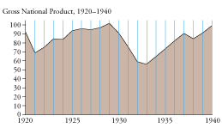
Effects on Business & Industry
GNP – $104 billion in 1929 to $56 billion in 1933
Total national income – fell by over 50%
Corporate profits - from $10 billion to $1 billon
Business failures: 100,000 between 1929 and 1933
Notes:
Brinkley 10e

Slide 8
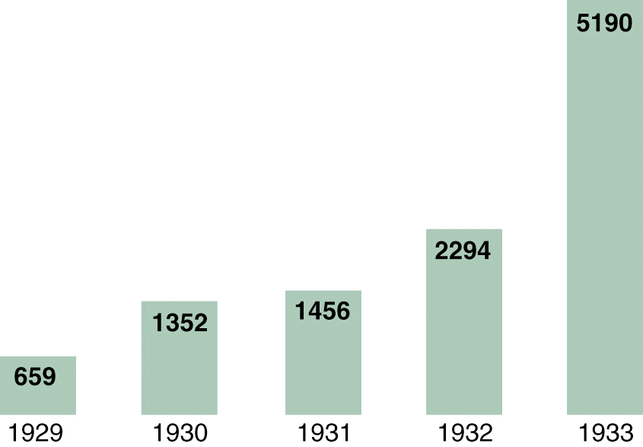
Effects on Business & Industry
Bank failures
  about 20% all banks (over 6000) between 1929 and 1933)
  over 9 million savings accounts lost($2.5 billion)
Bank Failures, 1929-1933
Notes:
Graph: Divine America Past and Present Revised 7th Ed.
Outside Bank: http://www.wadsworth.com/history_d/special_features/image_bank_US/1929_1939.html
American Journey Online

Slide 9
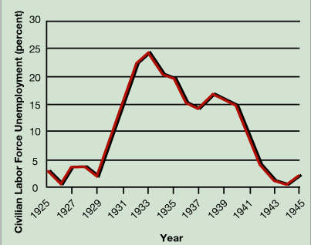

Effect on workers and families
Unemployment ~25% in 1932?
  underemployment
  patterns of reemployment and layoffs
hobos
“Depression mentality”
Notes:
This photograph shows men lined up at the New York City Employment Bureau. In the early years of the Great Depression, in the absence of federal jobs programs or of any sort of local or state unemployment assistance, people turned to agencies such as the New York City Employment Bureau to look for work. Nationally, the unemployment rate had risen from 3 percent in 1929 to 6.3 percent in 1930 and to 16.5 percent in 1931; it stood at 29.4 percent in 1932, the year this photograph was taken. [ajo]
Unemployment Graph: Faragher, Out of Many, 3rd Ed.; http://wps.prenhall.com/hss_faragher_outofmany_ap/

Slide 10
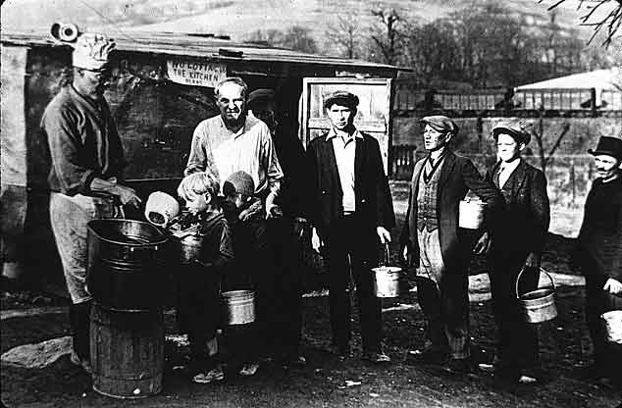
Effect on workers and families
Malnutrition
  Disease: tuberculosis, typhoid and dysentery.
City & state relief systems in industrial Northeast and Midwest collapse
soup kitchens and bread lines
Notes:
http://www.wadsworth.com/history_d/special_features/image_bank_US/1929_1939.html (Chicago)
http://www.wadsworth.com/history_d/special_features/image_bank_US/1929_1939.html

Slide 11
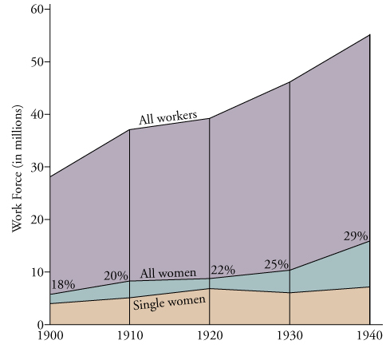
Effect on workers and families
Women
  Working - 25% more
  New Deal – lower pay
  Women’s Rights Movement - lowest point in a century
Families
  Housing
  Stress - divorce
  Health – disease, suicide
  Migrants - from South and Midwest to West
Notes:
Women in Workplace: Brinkley 10e; This photograph was taken by Resettlement Administration (RA) photographer Carl Mydans (b. 1907) in March 1936. It shows a woman and her two children in the abandoned chassis of a Ford automobile--their home--on U.S. Route 70 in Tennessee. [ajo]

Slide 12
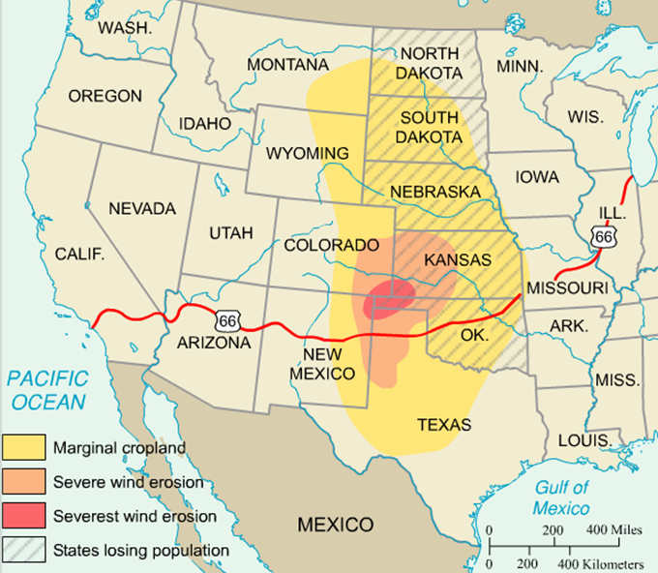
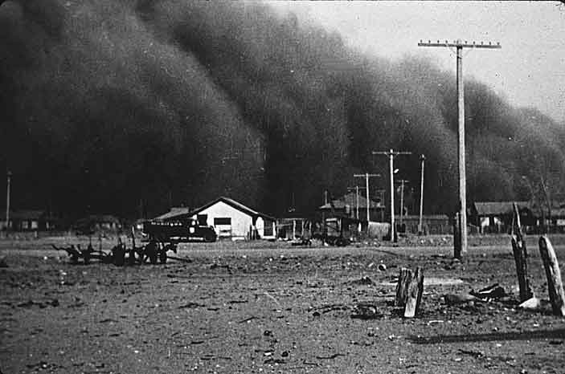
Effects on Farmers
“Dust Bowl”
“Okies”
Grapes of Wrath
Notes:
Pageant 13e

Slide 13
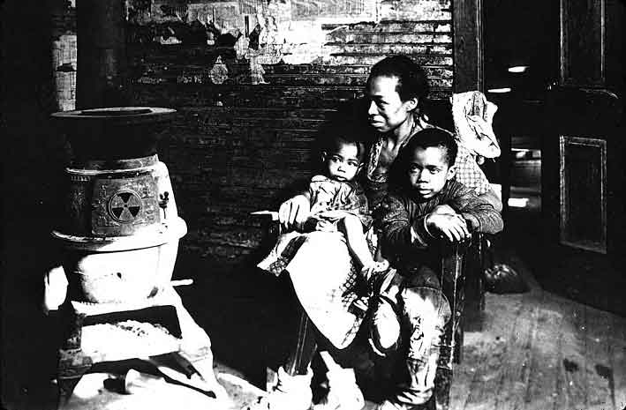

Effects on African Americans
High Unemployment – up to 50%: Last hired, first fired
  Competition for jobs
  Exclusion from relief programs
Help from the New Deal?
labor unions
Scottsboro Case
Notes:
This photograph, taken in January 1939 by Arthur Rothstein (1915-1985), a photographer with the federal Farm Security Administration (FSA), shows a mother and child, their spring mattress propped up behind them, along U.S. Route 60 in New Madrid County, Missouri. The woman and her family were sharecroppers evicted by their landlord at the height of winter. Evicted Sharecroppers along Highway 60 in Missouri. Rothstein, Arthur. 1939 [ajo]
http://www.wadsworth.com/history_d/special_features/image_bank_US/1929_1939.html

Slide 14

Effects on American Culture
Reactions of most Americans
  Effects on basic values (capitalism, democracy, individualism)
  Alternatives: socialism, communism?
  Whom to blame?
Popular Culture and Escapism
  Frank Capra
  Walt Disney
  Gone With the Wind

Slide 15
Effects on Politics
Republican domination of government ended
Power of federal government increased greatly – New Deal
Socialism and Communism - failed to become a major force in American politics. Why???
  Socialist party of America - Norman Thomas
  American Communist party of the 1930s
    Lincoln Brigade
    The Popular Front
    Nazi-Soviet Nonaggression Pact (1939)

Slide 16
HOOVER’S RESPONSE

Slide 17
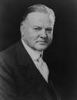
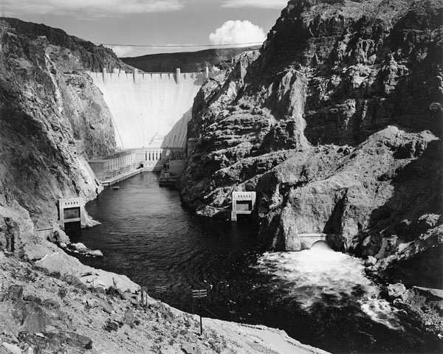
Federal Response Under Hoover
Herbert Hoover (1929-1933)
  Philosophy: limited government, individualism
  Initial response?
public works programs
Hawley-Smoot Tariff (1930)
Debt moratorium
International Banking Crisis (1931)- gold standard
Reconstruction Finance Corporation (1932)
Notes:
Library of Congress Brinkley; "Boulder Dam, 1942“, By Ansel Adams, Nevada; National Archives and Records Administration, Records of the National Park Service
(79-AAB-4); PBS American Photography

